Slide 1
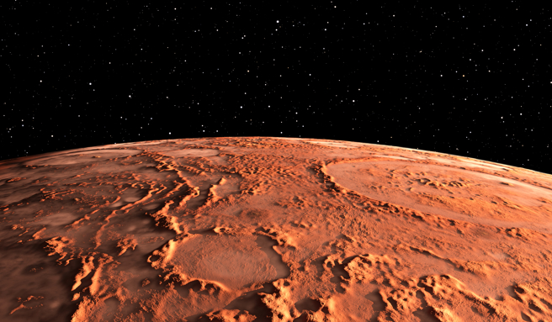
TEACHING EDGE
授課教授: 施信毓 教授
組別: G02
組員: 楊承叡、蘇俊宇、鄭祺學

Slide 2
Teaching Flow
Activity Flow Control
Procedural Timing Control
Procedural Assignment
&
Procedural Continuous Assignment

Slide 3
Teaching Flow
Activity Flow Control
Procedural Timing Control
Procedural Assignment
&
Procedural Continuous Assignment

Slide 4
Activity Flow Control
** Notes
com: combinational
conditional operator (…)?: | 條件運算子，可直接用在procedural statement
case, casex, casez | case: 多重條件判斷，需要bitwise match，不可用? casex: 忽略 X 和 Z 的條件判斷，可用? casez: 忽略 Z (高阻值) 的多重條件判斷，可用? **com時注意default避免unwanted latch，若default 為不需要的訊號則寫x
if-else | 條件判斷流程控制 **com時注意else避免unwanted latch，若else 為不需要的訊號則寫x
Loops: repeat, for, while, forever | repeat: 重複執行固定次數 **不可合成 for: 計數器的循環 **可合成 while: 條件為真時繼續執行 **不可合成 forever: 無限循環 **不可合成
disable | 用於跳出循環或提前結束程序 **可合成
fork-join | 並行處理多個事件 **不可合成 **注意不要發生Race Condition

Slide 5
實例

Slide 6
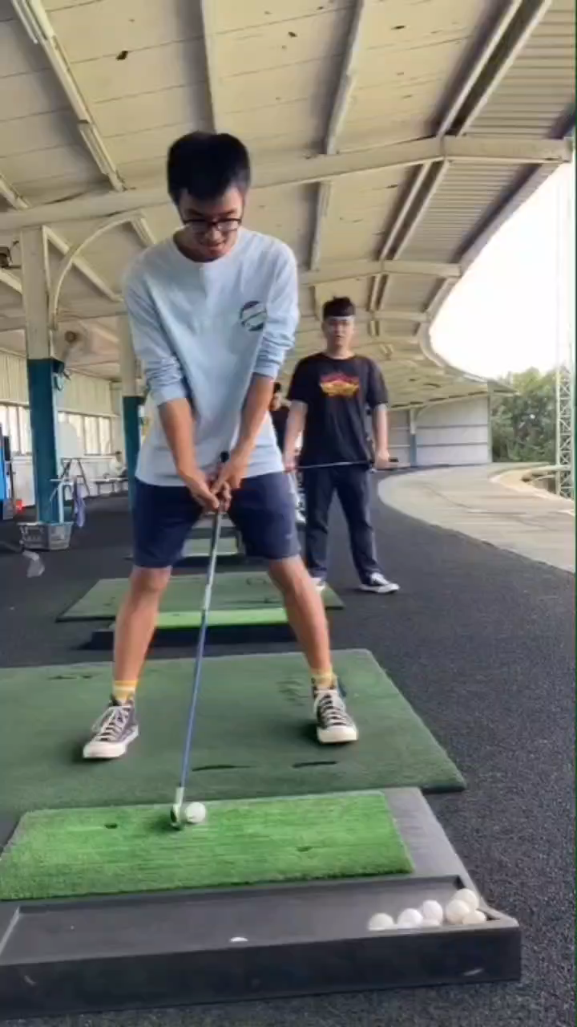
實例

Slide 7
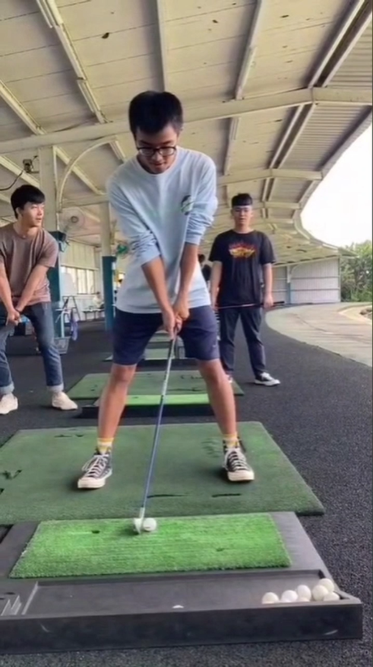


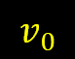

實例
$$v_{0}×\sin{θ}$$
$$v_{0}$$
$$θ$$
$$v_{0}×\cos{θ}$$

Slide 8
實例
$$v_{0}×\sin{θ}$$
$$v_{0}$$
$$θ$$
$$v_{0}×\cos{θ}$$

Slide 9

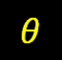
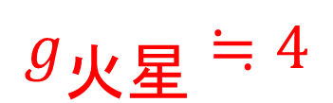
實例
$$g_{火星}≒4$$
$$v_{0}×\sin{θ}$$
$$v_{0}$$
$$θ$$
$$v_{0}×\cos{θ}$$

Slide 10
實例
$$g_{火星}≒4$$
$$v_{0}$$
$$v_{0}×\cos{θ}$$

Slide 11

實例
$$g_{火星}≒4$$
$$v_{0}$$
$$v_{0}×\cos{θ}×t$$

Slide 12
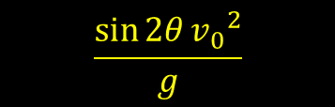
實例
$$g_{火星}≒4$$
$$v_{0}$$
$$\frac{\sin{2θ}{v_{0}}^{2}}{g}$$

Slide 13
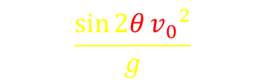
實例
$$g_{火星}≒4$$
$$v_{0}$$
$$\frac{\sin{2θ}{v_{0}}^{2}}{g}$$

Slide 14
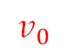
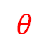
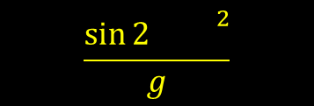
實例
Real Circuit
module golf (
output [7:0] dis,
output done,
output fail.
output reg [8:0] position,
output [1:0] error,
input [4:0] v0,
input [5:0] theta,
input clk,
input rst
);
$$\frac{\sin{2 }{}^{2}}{g}$$
$$v_{0}$$
$$θ$$

Slide 15
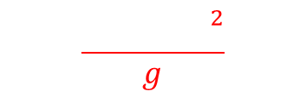


實例
Real Circuit
module golf (
output [7:0] dis,
output done,
output fail.
output reg [8:0] position,
output [1:0] error,
input [4:0] v0,
input [5:0] theta,
input clk,
input rst
);
wire [2:0] v0_square;
wire [5:0] path;
assign v0_square = (v0 == 5'b01000) ? v0>>3 :
(v0 == 5'b10000) ? v0>>2 : 2'bxx;
assign path = (v0_squar
e == 3'b001) ? (sin2theta_64>>2) * v0_square : sin2theta_64 * (v0_square>>2);
assign dis = 8'b1111010 - position;
assign done = (dis == 0) ? 1 : 0;
always @(*) begin
casex (theta)
6'b000001 : sin2theta_64 = 6'b000010;
6'b00001? : sin2theta_64 = 6'b000100;
6'b0001?? : sin2theta_64 = 6'b001011;
6'b001??? : sin2theta_64 = 6'b011010;
6'b01???? : sin2theta_64 = 6'b101111;
6'b1????? : sin2theta_64 = 6'b111111;
default: sin2theta_64 = 6'bxxxxxx;
endcase
module golf (
output [7:0] dis,
output done,
output fail.
output reg [8:0] position,
output [1:0] error,
input [4:0] v0,
input [5:0] theta,
input clk,
input rst
);
Theta Range
1
2~3
4~7
8~15
16~31
32~63
$$\sin{2 }$$
$$\frac{{ }^{2}}{g}$$
$$\frac{{ }^{2}}{g}$$

Slide 16
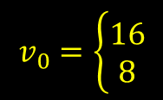
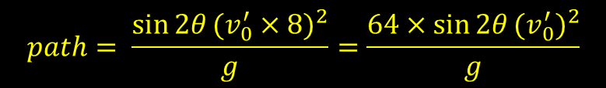
實例
Real Circuit
module golf (
output [7:0] dis,
output done,
output fail.
output reg [8:0] position,
output [1:0] error,
input [4:0] v0,
input [5:0] theta,
input clk,
input rst
); wire [2:0] v0_square;
wire [5:0] path;
reg [5:0] sin2theta_64
assign v0_square = (v0 == 5'b01000) ? v0>>3 :
(v0 == 5'b10000) ? v0>>2 : 2'bxx;
assign path = (v0_square == 3'b001) ? (sin2theta_64>>2) * v0_square : sin2theta_64 * (v0_square>>2);
assign dis = 9'b01111010 - position;
assign done = (dis == 0) ? 1 : 0;
assign error = (|(theta)) ? (&{~|({v0[0], v0[1], v0[2]}), ^({v0[3], v0[4]})}) ? 2'bxx: 2'b01 : 2'b10;
assign fail = (position > 9'b01111010) ? 1 : 0; always @(*) begin
casex (theta)
6'b000001 : sin2theta_64 = 6'b000010;
6'b00001? : sin2theta_64 = 6'b000100;
6'b0001?? : sin2theta_64 = 6'b001011;
6'b001??? : sin2theta_64 = 6'b011010;
6'b01???? : sin2theta_64 = 6'b101111;
6'b1????? : sin2theta_64 = 6'b111111;
default: sin2theta_64 = 6'bxxxxxx;
endcase
end
always @(posedge clk or posedge rst) begin
if (rst) begin
position <= 0;
end
else begin
position <= position + path;
end
end
endmodule
$$v_{0}=\left\{\begin{aligned}16 \\ 8\end{aligned}\right.$$
$$path= \frac{\sin{2θ}{(v_{0}^{′}×8)}^{2}}{g}=\frac{64×\sin{2θ}{(v_{0}^{′})}^{2}}{g}$$

Slide 17
實例
Real Circuit
module golf (
output [7:0] dis,
output done,
output fail.
output reg [8:0] position,
output [1:0] error,
input [4:0] v0,
input [5:0] theta,
input clk,
input rst
); wire [2:0] v0_square;
wire [5:0] path;
reg [5:0] sin2theta_64
assign v0_square = (v0 == 5'b01000) ? v0>>3 :
(v0 == 5'b10000) ? v0>>2 : 2'bxx;
assign path = (v0_square == 3'b001) ? (sin2theta_64>>2) : sin2theta_64;
assign dis = 9'b01111010 - position;
assign done = (dis == 0) ? 1 : 0;
assign error = (|(theta)) ? (&{~|({v0[0], v0[1], v0[2]}), ^({v0[3], v0[4]})}) ? 2'bxx: 2'b01 : 2'b10;
assign fail = (position > 9'b01111010) ? 1 : 0; always @(*) begin
casex (theta)
6'b000001 : sin2theta_64 = 6'b000010;
6'b00001? : sin2theta_64 = 6'b000100;
6'b0001?? : sin2theta_64 = 6'b001011;
6'b001??? : sin2theta_64 = 6'b011010;
6'b01???? : sin2theta_64 = 6'b101111;
6'b1????? : sin2theta_64 = 6'b111111;
default: sin2theta_64 = 6'bxxxxxx;
endcase
end
always @(posedge clk or posedge rst) begin
if (rst) begin
position <= 0;
end
else begin
position <= position + path;
end
end
endmodule

Slide 18
Teaching Flow
Activity Flow Control
Procedural Timing Control
Procedural Assignment
&
Procedural Continuous Assignment

Slide 19
Teaching Flow
Activity Flow Control
Procedural Timing Control
Procedural Assignment
&
Procedural Continuous Assignment

Slide 20
Procedural Timing Control
** Notes
Delay control operator (#) | 指定延遲時間 **不可合成
Event control operator (@) | 在特定事件發生時執行 **做為執行前的事件觸發需注意若事件沒來將不會執行後面，不可合成 **做為alway block 判斷，可合成
Event “or” | 多個事件的or運算，任一事件發生即觸發 **需注意若用posedge 觸發，進來在if就用1來判斷，negedge同理
Named Events (->) | 對事件命名，且只能在module中命名 **不可合成
wait construct | 等待直到條件成立才往後執行，若未成立則無法往後 **不可合成

Slide 21
實例
Real Circuit
module golf (
output [7:0] dis,
output done,
output fail.
output reg [8:0] position,
output [1:0] error,
input [4:0] v0,
input [5:0] theta,
input clk,
input rst
); wire [2:0] v0_square;
wire [5:0] path;
reg [5:0] sin2theta_64
assign v0_square = (v0 == 5'b01000) ? v0>>3 :
(v0 == 5'b10000) ? v0>>2 : 2'bxx;
assign path = (v0_square == 3'b001) ? (sin2theta_64>>2) : sin2theta_64;
assign dis = 9'b01111010 - position;
assign done = (dis == 0) ? 1 : 0;
assign error = (|(theta)) ? (&{~|({v0[0], v0[1], v0[2]}), ^({v0[3], v0[4]})}) ? 2'bxx: 2'b01 : 2'b10;
assign fail = (position > 9'b01111010) ? 1 : 0; always @(*) begin
casex (theta)
6'b000001 : sin2theta_64 = 6'b000010;
6'b00001? : sin2theta_64 = 6'b000100;
6'b0001?? : sin2theta_64 = 6'b001011;
6'b001??? : sin2theta_64 = 6'b011010;
6'b01???? : sin2theta_64 = 6'b101111;
6'b1????? : sin2theta_64 = 6'b111111;
default: sin2theta_64 = 6'bxxxxxx;
endcase
end
always @(posedge clk or posedge rst) begin
if (rst) begin
position <= 0;
end
else begin
position <= position + path;
end
end
endmodule

Slide 22
實例
Real Circuit
);
wire [2:0] v0_square;
wire [5:0] path;
reg [5:0] sin2theta_64
assign v0_square = (v0 == 5'b01000) ? v0>>3 :
(v0 == 5'b10000) ? v0>>2 : 2'bxx;
assign path = (v0_square == 3'b001) ? (sin2theta_64>>2) : sin2theta_64;
assign dis = 9'b01111010 - position;
assign done = (dis == 0) ? 1 : 0;
assign error = (|(theta)) ? (&{~|({v0[0], v0[1], v0[2]}), ^({v0[3], v0[4]})}) ? 2'bxx: 2'b01 : 2'b10;
assign fail = (position > 9'b01111010) ? 1 : 0; always @(*) begin
casex (theta)
6'b000001 : sin2theta_64 = 6'b000010;
6'b00001? : sin2theta_64 = 6'b000100;
6'b0001?? : sin2theta_64 = 6'b001011;
6'b001??? : sin2theta_64 = 6'b011010;
6'b01???? : sin2theta_64 = 6'b101111;
6'b1????? : sin2theta_64 = 6'b111111;
default: sin2theta_64 = 6'bxxxxxx;
endcase
end
always @(posedge clk or posedge rst) begin
if (rst) begin
position <= 0;
end
else begin
position <= position + path;
end
end
endmodule

Slide 23
實例
Real Circuit
assign v0_square = (v0 == 5'b01000) ? v0>>3 :
(v0 == 5'b10000) ? v0>>2 : 2'bxx;
assign path = (v0_square == 3'b001) ? (sin2theta_64>>2) : sin2theta_64;
assign dis = 9'b01111010 - position;
assign done = (dis == 0) ? 1 : 0;
assign error = (|(theta)) ? (&{~|({v0[0], v0[1], v0[2]}), ^({v0[3], v0[4]})}) ? 2'bxx: 2'b01 : 2'b10;
assign fail = (position > 9'b01111010) ? 1 : 0; always @(*) begin
casex (theta)
6'b000001 : sin2theta_64 = 6'b000010;
6'b00001? : sin2theta_64 = 6'b000100;
6'b0001?? : sin2theta_64 = 6'b001011;
6'b001??? : sin2theta_64 = 6'b011010;
6'b01???? : sin2theta_64 = 6'b101111;
6'b1????? : sin2theta_64 = 6'b111111;
default: sin2theta_64 = 6'bxxxxxx;
endcase
end
always @(posedge clk or posedge rst) begin
if (rst) begin
position <= 0;
end
else begin
position <= position + path;
end
end
endmodule

Slide 24
實例
Real Circuit
always @(*) begin
casex (theta)
6'b000001 : sin2theta_64 = 6'b000010;
6'b00001? : sin2theta_64 = 6'b000100;
6'b0001?? : sin2theta_64 = 6'b001011;
6'b001??? : sin2theta_64 = 6'b011010;
6'b01???? : sin2theta_64 = 6'b101111;
6'b1????? : sin2theta_64 = 6'b111111;
default: sin2theta_64 = 6'bxxxxxx;
endcase
end
always @(posedge clk or posedge rst) begin
if (rst) begin
position <= 0;
end
else begin
position <= position + path;
end
end
endmodule

Slide 25
實例
Real Circuit
always @(posedge clk or posedge rst) begin
if (rst) begin
position <= 0;
end
else begin
position <= position + path;
end
end
endmodule
Priority:
rst > clk
Asynchronous

Slide 26
實例
Test Bench
module golf_tb; .
. golf GOLF(...);
.
. initial begin
.
.
for (i=0; i<5; i=i+1) begin
.
.
#20;
end
$display("You Lose!!");
$finish;
end
initial begin
wait(fail)
$display("You Lose!!");
$finish;
end
initial begin
wait(done)
$display("You're winning on the %o step!!!", i+1'b1);
$finish;
end
initial begin #150 $finish;
endmodule
實際變動input訊號，
打完5個pattern後結束模擬。
從模擬一開始就在檢查失敗(fail)
訊號，若失敗則結束模擬。
從模擬一開始就在等待完成(done)
訊號，等到完成後結束模擬。
以防上面電路都有問題沒跑到$finish。

Slide 27
Teaching Flow
Activity Flow Control
Procedural Timing Control
Procedural Assignment
&
Procedural Continuous Assignment

Slide 28
Teaching Flow
Activity Flow Control
Procedural Timing Control
Procedural Assignment
&
Procedural Continuous Assignment

Slide 29
Procedural Assignment
** Notes
initial block | 由上至下執行一次，適合用於設定初始值 **不可合成
always block | 由上至下持續執行，block中等號左邊必為reg **可合成
blocking & non-blocking assignment | 會先完成這個assignment才會開始下一個assignment (蓋火鍋) 下一個assignment不用等，可以一起開始 (不蓋火鍋)
Procedural Continuous Assignment (PCA)
** Notes
assign...deassign | 動態綁定reg變數，將會在deassign或新的PCA才被移除 **可合成但要看Tool
force...release | 動態綁定net or reg變數，只會在release或新的force解除 **不可合成

Slide 30
實例
Test Bench
module golf_tb;
reg clk;
reg rst;
reg [4:0] v0_pattern [0:4];
reg [4:0] v0;
reg [5:0] theta;
reg [2:0] i;
wire [7:0] dis;
wire done;
wire fail;
wire [7:0] pos;
wire [1:0] error;
golf GOLF(...);
function [5:0] theta_ctrl;
input [7:0] dis_ctrl;
input [4:0] v0_ctrl;
reg [10:0] dis_8;
reg [10:0] plus;
begin
dis_8 = dis_ctrl<<3;
plus = dis_8 + v0_ctrl + 5'd24;
theta_ctrl = plus / 5'd20;
end
endfunction
always #10 clk = ~clk;
initial begin
$fsdbDumpfile("geofence.fsdb");
$fsdbDumpvars();
$fsdbDumpMDA;
end
initial $readmemb("test_pattern.dat",v0_pattern);
initial begin
clk = 0;
rst = 1;
#25
rst = 0;
for (i=0; i<5; i=i+1) begin
v0 <= v0_pattern[i];
theta <= theta_ctrl(dis, v0);
if (error !== 2'bxx) begin
$display("ERROR MESSAGE: %b!!!", error);
$finish;
end
#20;
end
$display("You Lose!!");
$finish;
end
initial begin
wait(fail)
$display("You Lose!!");
$finish;
end
initial begin
wait(done)
$display("You're winning on the %o step!!!", i+1'b1);
$finish;
end
initial begin #150 $finish;
endmodule

Slide 31
實例
Test Bench
module golf_tb; .
golf GOLF(...);
function [5:0] theta_ctrl;
input [7:0] dis_ctrl;
input [4:0] v0_ctrl;
reg [10:0] dis_8;
reg [10:0] plus;
begin
dis_8 = dis_ctrl<<3;
plus = dis_8 + v0_ctrl + 5'd24;
theta_ctrl = plus / 5'd20;
end
endfunction
always #10 clk = ~clk;
initial begin
$fsdbDumpfile("geofence.fsdb");
$fsdbDumpvars();
$fsdbDumpMDA;
end
initial $readmemb("test_pattern.dat",v0_pattern);
initial begin
clk = 0;
rst = 1;
#25
rst = 0;
for (i=0; i<5; i=i+1) begin
v0 <= v0_pattern[i];
theta <= theta_ctrl(dis, v0);
if (error !== 2'bxx) begin
$display("ERROR MESSAGE: %b!!!", error);
$finish;
end
#20;
end
$display("You Lose!!");
$finish;
end
initial begin
wait(fail)
$display("You Lose!!");
$finish;
end
initial begin
wait(done)
$display("You're winning on the %o step!!!", i+1'b1);
$finish;
end
initial begin #150 $finish;
endmodule

Slide 32
實例
Test Bench
module golf_tb; .. function [5:0] theta_ctrl;
input [7:0] dis_ctrl;
input [4:0] v0_ctrl;
reg [10:0] dis_8;
reg [10:0] plus;
begin
dis_8 = dis_ctrl<<3;
plus = dis_8 + v0_ctrl + 5'd24;
theta_ctrl = plus / 5'd20;
end
endfunction
always #10 clk = ~clk;
initial begin
$fsdbDumpfile("geofence.fsdb");
$fsdbDumpvars();
$fsdbDumpMDA;
end
initial $readmemb("test_pattern.dat",v0_pattern);
initial begin
clk = 0;
rst = 1;
#25
rst = 0;
for (i=0; i<5; i=i+1) begin
v0 <= v0_pattern[i];
theta <= theta_ctrl(dis, v0);
if (error !== 2'bxx) begin
$display("ERROR MESSAGE: %b!!!", error);
$finish;
end
#20;
end
$display("You Lose!!");
$finish;
end
initial begin
wait(fail)
$display("You Lose!!");
$finish;
end
initial begin
wait(done)
$display("You're winning on the %o step!!!", i+1'b1);
$finish;
end
initial begin #150 $finish;
endmodule

Slide 33
實例
Test Bench
module golf_tb; ... function [5:0] theta_ctrl;
input [7:0] dis_ctrl;
input [4:0] v0_ctrl;
reg [10:0] dis_8;
reg [10:0] plus;
begin
dis_8 = dis_ctrl<<3;
plus = dis_8 + v0_ctrl + 5'd24;
theta_ctrl = plus / 5'd20;
end
endfunction .
initial $readmemb("test_pattern.dat",v0_pattern);
initial begin
clk = 0;
rst = 1;
#25
rst = 0;
for (i=0; i<5; i=i+1) begin
v0 <= v0_pattern[i];
theta <= theta_ctrl(dis, v0);
if (error !== 2'bxx) begin
$display("ERROR MESSAGE: %b!!!", error);
$finish;
end
#20;
end
$display("You Lose!!");
$finish;
end
initial begin
wait(fail)
$display("You Lose!!");
$finish;
end
initial begin
wait(done)
$display("You're winning on the %o step!!!", i+1'b1);
$finish;
end
initial begin #150 $finish;
endmodule

Slide 34
實例
Test Bench
module golf_tb; ... function [5:0] theta_ctrl;
input [7:0] dis_ctrl;
input [4:0] v0_ctrl;
reg [10:0] dis_8;
reg [10:0] plus;
begin
dis_8 = dis_ctrl<<3;
plus = dis_8 + v0_ctrl + 5'd24;
theta_ctrl = plus / 5'd20;
end
endfunction ... initial begin
clk = 0;
rst = 1;
#25
rst = 0;
for (i=0; i<5; i=i+1) begin
v0 <= v0_pattern[i];
theta <= theta_ctrl(dis, v0);
if (error !== 2'bxx) begin
$display("ERROR MESSAGE: %b!!!", error);
$finish;
end
#20;
end
$display("You Lose!!");
$finish;
end
initial begin
wait(fail)
$display("You Lose!!");
$finish;
end
initial begin
wait(done)
$display("You're winning on the %o step!!!", i+1'b1);
$finish;
end
initial begin #150 $finish;
endmodule

Slide 35
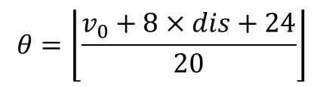
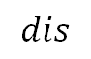
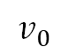
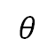
實例
Test Bench
module golf_tb; ... function [5:0] theta_ctrl;
input [7:0] dis_ctrl;
input [4:0] v0_ctrl;
reg [10:0] dis_8;
reg [10:0] plus;
begin
dis_8 = dis_ctrl<<3;
plus = dis_8 + v0_ctrl + 5'd24;
theta_ctrl = plus / 5'd20;
end
endfunction ... initial begin
clk = 0;
rst = 1;
#25
rst = 0;
for (i=0; i<5; i=i+1) begin
v0 <= v0_pattern[i];
theta <= theta_ctrl(dis, v0);
if (error !== 2'bxx) begin
$display("ERROR MESSAGE: %b!!!", error);
$finish;
end
#20;
end
$display("You Lose!!");
$finish;
end
... endmodule
Theta Controller
$$θ=\left\lfloor \frac{v_{0}+8×dis+24}{20}\right\rfloor$$
Testbench
Theta
Controller
$$θ$$
GOLF module
$$v_{0}$$
$$dis$$

Slide 36
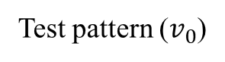
實例
Test Bench
10000
10000
10000
01000
01000
Test pattern ($v_{0}$)
module golf_tb; ... function [5:0] theta_ctrl;
input [7:0] dis_ctrl;
input [4:0] v0_ctrl;
reg [10:0] dis_8;
reg [10:0] plus;
begin
dis_8 = dis_ctrl<<3;
plus = dis_8 + v0_ctrl + 5'd24;
theta_ctrl = plus / 5'd20;
end
endfunction ... initial begin
clk = 0;
rst = 1;
#25
rst = 0;
for (i=0; i<5; i=i+1) begin
v0 <= v0_pattern[i];
theta <= theta_ctrl(dis, v0);
if (error !== 2'bxx) begin
$display("ERROR MESSAGE: %b!!!", error);
$finish;
end
#20;
end
$display("You Lose!!");
$finish;
end
... endmodule
Expect:
You're winning on the 4 step!!!
What we got:

Slide 37
實例
Test Bench
10000
10000
10000
01000
01000
Test pattern ($v_{0}$)
module golf_tb; ... function [5:0] theta_ctrl;
input [7:0] dis_ctrl;
input [4:0] v0_ctrl;
reg [10:0] dis_8;
reg [10:0] plus;
begin
dis_8 = dis_ctrl<<3;
plus = dis_8 + v0_ctrl + 5'd24;
theta_ctrl = plus / 5'd20;
end
endfunction ... initial begin
clk = 0;
rst = 1;
#25
rst = 0;
for (i=0; i<5; i=i+1) begin
v0 <= v0_pattern[i];
theta <= theta_ctrl(dis, v0);
if (error !== 2'bxx) begin
$display("ERROR MESSAGE: %b!!!", error);
$finish;
end
#20;
end
$display("You Lose!!");
$finish;
end
... endmodule
Expect:
You're winning on the 4 step!!!
What we got:
initial begin
force theta = 6'b110010;
wait(i==3'b001) force theta = 6'b011001;
wait(i==3'b010) force theta = 6'b000110;
wait(i==3'b011) force theta = 6'b000010;
end

Slide 38
實例
Test Bench
10000
10000
10000
01000
01000
Test pattern ($v_{0}$)
module golf_tb; ... function [5:0] theta_ctrl;
input [7:0] dis_ctrl;
input [4:0] v0_ctrl;
reg [10:0] dis_8;
reg [10:0] plus;
begin
dis_8 = dis_ctrl<<3;
plus = dis_8 + v0_ctrl + 5'd24;
theta_ctrl = plus / 5'd20;
end
endfunction ... initial begin
clk = 0;
rst = 1;
#25
rst = 0;
for (i=0; i<5; i=i+1) begin
v0 <= v0_pattern[i];
theta <= theta_ctrl(dis, v0);
if (error !== 2'bxx) begin
$display("ERROR MESSAGE: %b!!!", error);
$finish;
end
#20;
end
$display("You Lose!!");
$finish;
end
... endmodule
Expect:
You're winning on the 4 step!!!
What we got:
initial begin
force theta = 6'b110010;
wait(i==3'b001) force theta = 6'b011001;
wait(i==3'b010) force theta = 6'b000110;
wait(i==3'b011) force theta = 6'b000010;
end

Slide 39
實例
Test Bench
10000
10000
10000
01000
01000
Test pattern ($v_{0}$)
module golf_tb; ... function [5:0] theta_ctrl;
input [7:0] dis_ctrl;
input [4:0] v0_ctrl;
reg [10:0] dis_8;
reg [10:0] plus;
begin
dis_8 = dis_ctrl<<3;
plus = dis_8 + v0_ctrl + 5'd24;
theta_ctrl = plus / 5'd20;
end
endfunction ... initial begin
clk = 0;
rst = 1;
#25
rst = 0;
for (i=0; i<5; i=i+1) begin
v0 = v0_pattern[i];
theta = theta_ctrl(dis, v0);
if (error !== 2'bxx) begin
$display("ERROR MESSAGE: %b!!!", error);
$finish;
end
#20;
end
$display("You Lose!!");
$finish;
end
... endmodule
Expect:
You're winning on the 4 step!!!

Slide 40
實例
Test Bench
10000
10000
10000
01000
01000
Test pattern ($v_{0}$)
module golf_tb; ... function [5:0] theta_ctrl;
input [7:0] dis_ctrl;
input [4:0] v0_ctrl;
reg [10:0] dis_8;
reg [10:0] plus;
begin
dis_8 = dis_ctrl<<3;
plus = dis_8 + v0_ctrl + 5'd24;
theta_ctrl = plus / 5'd20;
end
endfunction ... initial begin
clk = 0;
rst = 1;
#25
rst = 0;
for (i=0; i<5; i=i+1) begin
v0 = v0_pattern[i];
theta = theta_ctrl(dis, v0);
if (error !== 2'bxx) begin
$display("ERROR MESSAGE: %b!!!", error);
$finish;
end
#20;
end
$display("You Lose!!");
$finish;
end
... endmodule
Expect:
You're winning on the 4 step!!!
What we got:

Slide 41
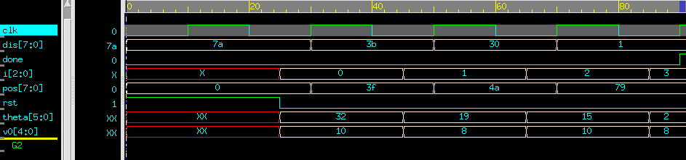
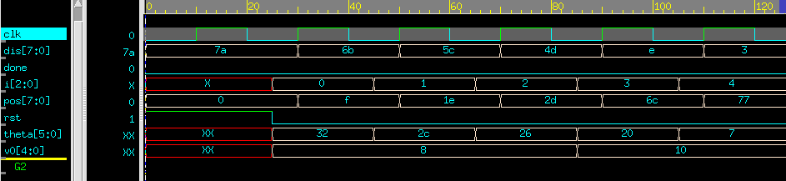
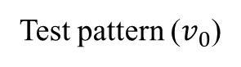
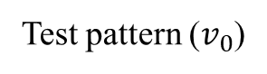
實例
Test Bench
10000
01000
10000
01000
01000
nWave:
Test pattern ($v_{0}$)
What we got:
01000
01000
01000
10000
10000
nWave:
Test pattern ($v_{0}$)
What we got:

Slide 42
隨堂測驗 (intra assignment delay)
…
reg a, b, c, d;
initial begin
fork
a = #3 1'b0;
b = 1'b1;
c = #4 a;
#4 d = b;
b = #3 a;
a = 1'b1;
#5 c = a;
join
end
initial begin
#20 $finish;
end
…

Slide 43
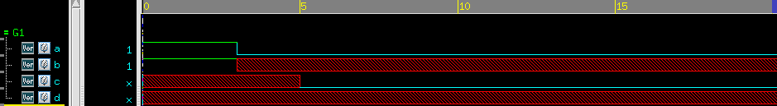
隨堂測驗 (intra assignment delay)
…
reg a, b, c, d;
initial begin
fork
a = #3 1'b0;
b = 1'b1;
c = #4 a;
#4 d = b;
b = #3 a;
a = 1'b1;
#5 c = a;
join
end
initial begin
#20 $finish;
end
…
Ans:

Slide 44
References
[1]施信毓 教授 DCIC LEC4 Part1
[2] https://www.chinatimes.com/hottopic/20220304004221-260809?chdtv (火星圖)
[3] https://cyclingtime.com/tw/documents/4710.html (高爾夫球圖)

